Slide 1
UCI SECOM Dataset
Semiconductor Manufacturing Process
A Manufacturing Quality Perspective
Hypothetical Defect Detection Enhancement Through The Careful Development Of A Robust Machine Learning Model

Slide 2
Objective Statement
To enhance defect detection in a semiconductor manufacturing process by developing a robust machine learning model using the hypothetical SECOM dataset, leveraging strategic data preprocessing, various advanced feature selection techniques to identify the most predictive features, and the optimization of a XGBoost classifier to achieve a relatively high target F1-score, ensuring a balance of simplicity, interpretability, and high performance for practical deployment.

Slide 3
The SECOM Dataset
(1567, 592)
The dataset consists of 1,567 records each with 592 total features.
The dataset presented in this case represents a selection of such features where each record represents a single production entity with associated measured features and a simple pass/fail yield for in house line testing.
In the Target column, “ –1” corresponds to a pass and “1” corresponds to a failure, and the Time stamp column is for that specific test point. This leaves 590 features potentially derived from process data collection for each production entity.
The features are labeled numerically 1 through 590 and intentionally have no dictionary describing what they are specifically.

Slide 4
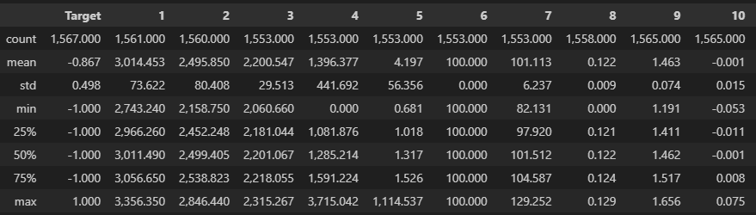
Strategic Data Preprocessing
Step 1: Generate descriptive statistics for dataset variables.
Step 2: Define outcome variable (Target) as Y and the explanatory variables (590) as X.
Step 3: Rename Y values to a binary format where “-1” becomes “0”, and “1” remains “1”.

Slide 5

Strategic Data Preprocessing (cont.)
Step 4: Assess missing values in X.
  X shows a presence of missing values (NaN) in approximately 91.2% of the features. 4.5% of X contains missing values (NaN). Seemingly reasonable justification to merit further investigation.

Slide 6
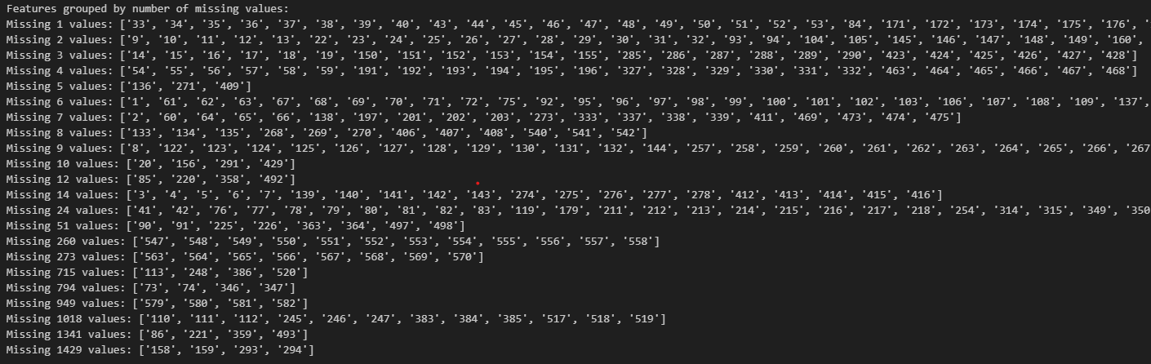
Strategic Data Preprocessing (cont.)
Step 5: Group X features by number of missing values to explore patterns.
  The missing values played out in 22 distinct layers, possibly indicating some other association between the features in each layer.

Slide 7
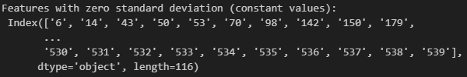

Strategic Data Preprocessing (cont.)
Step 6: Identify constant features in X for potential removal.
  Identify features with a Standard Deviation of 0.
    Verify their constant designation by checking to see if the minimum and maximum value are equal.
  116 features were identified as constant features for potential removal.

Slide 8
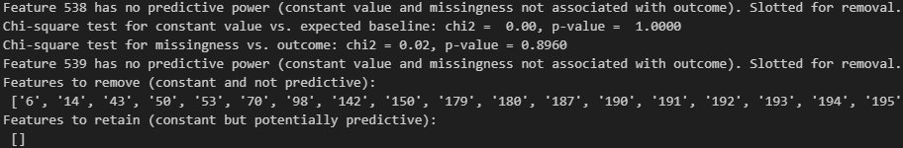
Strategic Data Preprocessing (cont.)
Step 7: Reconcile constant features with Y.
  Perform chi-square test for constant value distribution vs. expected baseline for pass/fail.
    The expected baseline for pass/fail is based on the total number of failures (104) divided by total number of records (1,567) equaling 0.0664 or 6.64%.
  Perform chi-square test for constant feature missingness vs. Y.
  All 116 constant features (their constant value and missingness) were not predictive.

Slide 9

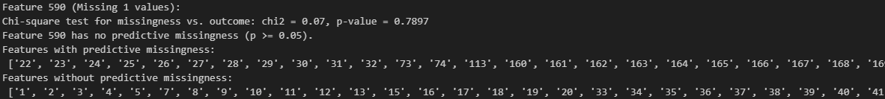
Strategic Data Preprocessing (cont.)
Step 8: Remove identified constant non-predictive features from X.
Step 9: Generate summary statistics of missingness in features remaining in X.
Step 10: Reconcile X remaining features missing values with Y.
  Perform chi-square test for feature missingness vs. Y.
  52 features were found to have predictive missingness.

Slide 10
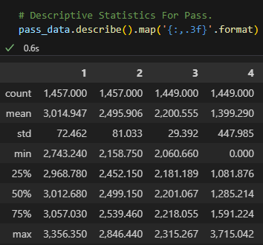
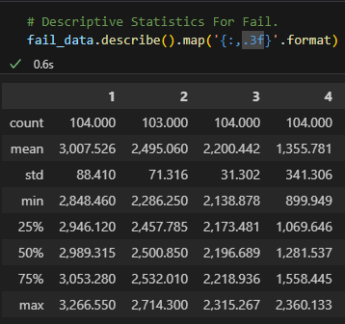
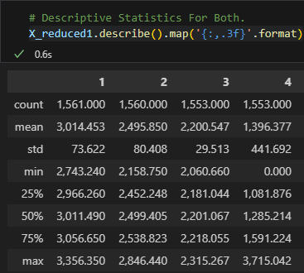
Strategic Data Preprocessing (cont.)
Step 11: Generate descriptive statistics for pass, fail, and combined remaining data separately.

Slide 11
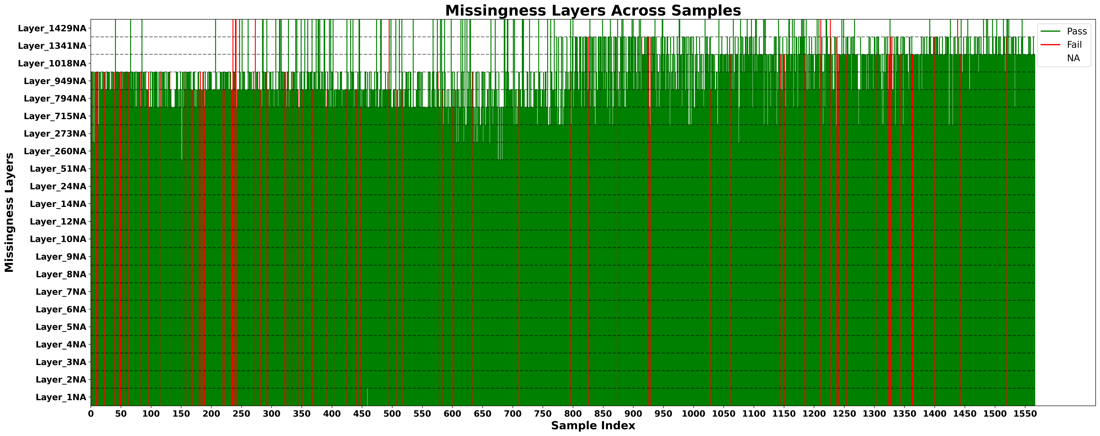
Strategic Data Preprocessing (cont.)
Step 12: Generate chart visualization of missingness layers across samples.

Slide 12
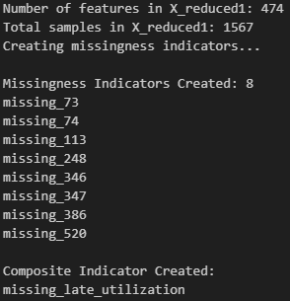
Strategic Data Preprocessing (cont.)
Step 13: Create a missingness indicator…
  for each predictive missingness features with 260 NaN or higher counts.
  to represent the late utilization of the layers 949NA, 1018NA, and 1341NA, after sample record 800.

Slide 13

Strategic Data Preprocessing (cont.)
Step 14: Create a variable calculating the proportion of NA features in a sample record.
Step 15: Remove features associated with layers 1341NA and 1429NA, given their insufficient number of values to provide some meaningful predictive influence.
  474 features + 10 previously added features – 8 removed features = 476 features

Slide 14
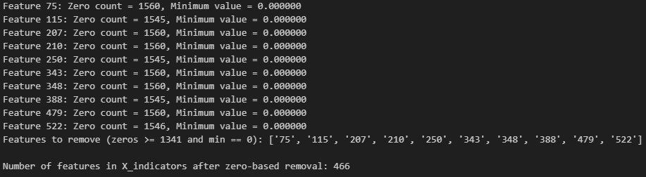
Strategic Data Preprocessing (cont.)
Step 16: Remove features with greater than or equal to 1,341 zero values and zero as a minimum value, given their insufficient number of non-zero values to provide some meaningful predictive influence.

Slide 15

Strategic Data Preprocessing (cont.)
Step 17: Covert feature zero to NaN values based on at least one of three criterion, prior to imputation.
  Feature distributions with a minimum zero value and significant left skew (< -0.5)
  Feature distributions with a negative minimum value, a maximum zero value, and a significant right skew (> 0.5)
  If zero falls outside non-zero distribution (IQR*1.5), with exception for less than an absolute maximum 0.05 value.
Step 18: Impute all NaN values…
  For features in layers 1NA to 794NA using feature pass and fail means.
  For features in 949NA and 1018NA use a hybrid approach…
    For sample records < 800, use feature mean.
    For sample records >= 800, use feature pass and fail means.
  Verify imputation completed.

Slide 16
Feature Selection
Step 1: Use feature selection methods to reduce the imputed feature dataset (476) to 100 features.
  SelectKBest Method
    Selected 100 features: ['15', '22', '23', '27', '29', '33', '34', '39', '41', '57', '59', '60', '64', '65', '66', '69', '71', '77', '80', '91', '96', '101', '104', '112', '113', '122', '123', '124', '125', '126', '127', '128', '130', '131', '134', '160', '161', '164', '165', '166', '167', '181', '184', '197', '198', '200', '201', '206', '211', '248', '281', '295', '296', '299', '300', '301', '317', '320', '338', '349', '366', '431', '432', '435', '436', '437', '438', '453', '456', '461', '469', '470', '472', '478', '511', '512', '520', '543', '544', '548', '551', '552', '554', '555', '557', '558', '563', '566', '568', '570', '574', '576', 'missing_73', 'missing_74', 'missing_113', 'missing_248', 'missing_346', 'missing_347', 'missing_386', 'missing_520’]
  Mutual Information Method
    Selected 100 features: ['3', '7', '20', '34', '35', '39', '41', '42', '56', '58', '66', '71', '73', '74', '89', '110', '111', '113', '120', '122', '123', '126', '127', '128', '129', '131', '135', '139', '226', '245', '246', '247', '248', '269', '274', '275', '276', '278', '289', '308', '309', '311', '332', '346', '347', '383', '385', '386', '406', '407', '408', '412', '413', '414', '417', '429', '444', '447', '448', '468', '478', '511', '518', '519', '520', '540', '542', '547', '548', '549', '550', '551', '552', '553', '554', '555', '556', '557', '558', '563', '564', '565', '566', '567', '568', '569', '570', '571', '572', '574', '575', '576', '577', '578', '579', '580', '581', '582', '584', '590’]
  Recursive Feature Elimination (RFE) with Logistic Regression
    Selected 100 features: ['15', '20', '21', '27', '32', '33', '35', '36', '37', '38', '48', '59', '60', '65', '66', '76', '78', '82', '84', '87', '97', '99', '100', '103', '109', '112', '118', '122', '125', '127', '129', '130', '131', '133', '141', '143', '146', '147', '151', '157', '173', '175', '176', '178', '185', '196', '203', '205', '212', '214', '215', '217', '218', '219', '248', '269', '270', '278', '286', '291', '306', '311', '313', '317', '319', '322', '334', '337', '339', '341', '349', '350', '352', '356', '391', '407', '412', '417', '425', '438', '444', '446', '447', '449', '455', '456', '458', '476', '517', '525', '546', '547', '553', '557', '558', '564', '565', '567', '572', 'missing_113']

Slide 17
Feature Selection (cont.)
  Recursive Feature Elimination (RFE) with XGBoost
    Selected 100 features: ['1', '11', '17', '22', '30', '34', '49', '60', '65', '68', '73', '74', '79', '80', '82', '85', '89', '92', '93', '96', '97', '103', '104', '113', '116', '118', '119', '121', '125', '126', '128', '130', '134', '139', '141', '147', '151', '156', '164', '173', '185', '189', '197', '215', '219', '239', '240', '248', '249', '253', '280', '284', '292', '296', '299', '321', '346', '347', '362', '363', '368', '386', '394', '417', '424', '427', '429', '431', '434', '438', '469', '470', '478', '489', '512', '520', '524', '547', '548', '549', '550', '552', '555', '556', '558', '562', '563', '564', '565', '567', '568', '569', '570', '576', '580', '581', '582', '588', 'missing_73', 'missing_113’]
  Random Forest Method
    Selected 100 features: ['248', '520', '386', '113', '347', 'missing_520', '74', 'missing_73', 'missing_347', 'missing_74', '346', '563', '581', '60', '565', '73', '478', '65', 'missing_346', '580', '427', '349', '566', '567', 'missing_113', '41', '133', '552', '342', '66', '570', '206', '555', '268', '63', '153', '558', '589', 'missing_386', '568', '438', '56', '249', '442', '289', '569', '3', '511', '52', '299', '68', '64', '332', '188', '540', '27', '412', '426', '406', 'missing_248', '154', '29', '164', '288', '5', '383', '121', '461', '208', '474', '28', '204', '108', '81', '495', '302', '353', '148', '578', '10', '445', '79', '518', '125', '338', '22', '71', '421', '524', '37', '200', '411', '120', '362', '39', '166', '122', '139', '112', '430’]
  L1 Regularization (Lasso) Method
    Selected 100 features: ['1', '2', '3', '4', '15', '16', '22', '23', '24', '25', '41', '47', '52', '56', '60', '63', '65', '68', '69', '71', '72', '73', '74', '89', '91', '116', '134', '136', '137', '138', '139', '141', '152', '153', '160', '162', '163', '184', '188', '189', '201', '205', '209', '224', '226', '251', '253', '269', '275', '295', '296', '297', '298', '341', '364', '414', '419', '420', '424', '426', '429', '432', '433', '434', '437', '439', '440', '457', '461', '468', '469', '472', '473', '474', '478', '483', '484', '485', '486', '487', '488', '489', '490', '491', '495', '497', '500', '501', '511', '512', '520', '542', '548', '556', '562', '563', '570', '573', '578', '582']

Slide 18
Feature Selection (cont.)
  Variance Threshold + SelectKBest
    Selected 315 features (Variance Threshold of 0.01): ['1', '2', '3', '4', '5', '7', '13', '15', '16', '17', '19', '20', '22', '23', '24', '25', '26', '27', '28', '29', '30', '32', '33', '34', '35', '36', '37', '38', '39', '40', '41', '42', '44', '45', '46', '47', '48', '49', '51', '52', '56', '60', '61', '62', '63', '64', '65', '66', '67', '68', '69', '71', '72', '73', '74', '84', '89', '91', '97', '99', '111', '112', '116', '118', '121', '123', '124', '125', '126', '127', '128', '129', '130', '134', '135', '136', '137', '138', '139', '140', '141', '143', '149', '151', '152', '153', '155', '156', '160', '161', '162', '163', '164', '165', '166', '167', '168', '170', '171', '176', '178', '181', '182', '183', '184', '185', '186', '188', '189', '196', '197', '198', '199', '200', '201', '202', '203', '204', '205', '206', '208', '209', '219', '224', '226', '246', '247', '251', '253', '256', '269', '270', '271', '272', '273', '274', '275', '276', '278', '284', '286', '287', '288', '290', '291', '295', '296', '297', '298', '300', '301', '302', '303', '313', '317', '319', '320', '322', '324', '325', '333', '334', '335', '336', '337', '338', '339', '340', '341', '342', '344', '345', '346', '347', '357', '362', '364', '384', '385', '389', '391', '407', '408', '409', '410', '411', '412', '413', '414', '416', '417', '418', '419', '420', '421', '422', '424', '425', '426', '427', '428', '429', '430', '431', '432', '433', '434', '435', '436', '437', '438', '439', '440', '441', '442', '443', '444', '445', '446', '447', '449', '453', '454', '455', '456', '457', '458', '460', '461', '468', '469', '470', '471', '472', '473', '474', '475', '476', '477', '478', '480', '481', '483', '484', '485', '486', '487', '488', '489', '490', '491', '492', '494', '495', '496', '497', '498', '500', '501', '511', '512', '517', '518', '519', '520', '521', '523', '524', '525', '526', '527', '528', '540', '541', '542', '546', '547', '548', '549', '550', '551', '552', '553', '554', '555', '556', '557', '558', '560', '562', '563', '564', '565', '567', '569', '570', '571', '572', '573', '574', '575', '577', '578', '582', '586', '590', 'missing_73', 'missing_74', 'missing_113', 'missing_248', 'missing_346', 'missing_347', 'missing_386', 'missing_520', 'missing_late_utilization’]
    Selected 100 features (Variance + SelectKBest): ['15', '22', '23', '27', '29', '32', '33', '34', '39', '41', '60', '64', '65', '66', '69', '71', '91', '112', '116', '123', '124', '125', '126', '127', '128', '130', '134', '139', '160', '161', '164', '165', '166', '167', '176', '181', '182', '184', '189', '197', '198', '200', '201', '204', '206', '295', '296', '300', '301', '302', '317', '320', '334', '338', '342', '412', '417', '418', '424', '431', '432', '434', '435', '436', '437', '438', '453', '456', '461', '469', '470', '472', '476', '478', '485', '489', '511', '512', '520', '546', '548', '551', '552', '554', '555', '557', '558', '563', '570', '574', '578', 'missing_73', 'missing_74', 'missing_113', 'missing_248', 'missing_346', 'missing_347', 'missing_386', 'missing_520', 'missing_late_utilization']

Slide 19
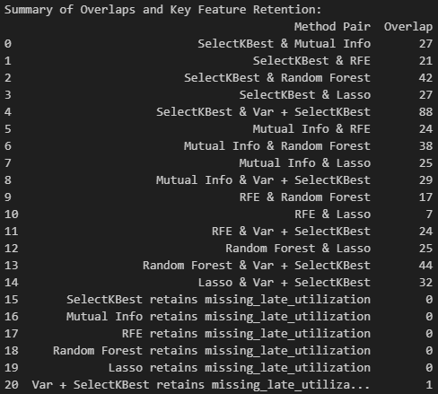
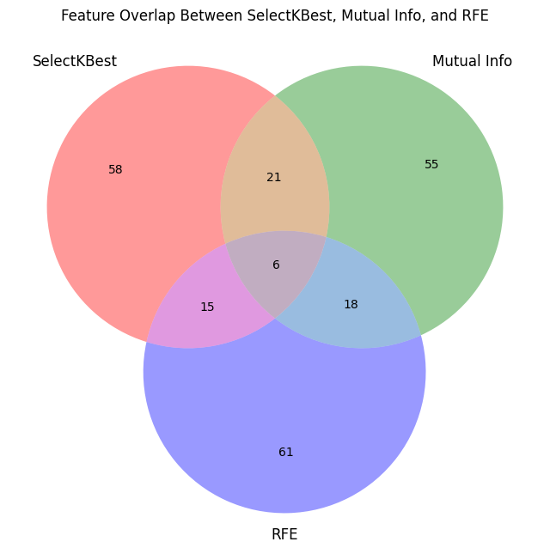
Feature Selection (cont.)
  Step 2: Summary of Overlays and a Venn Diagram

Slide 20
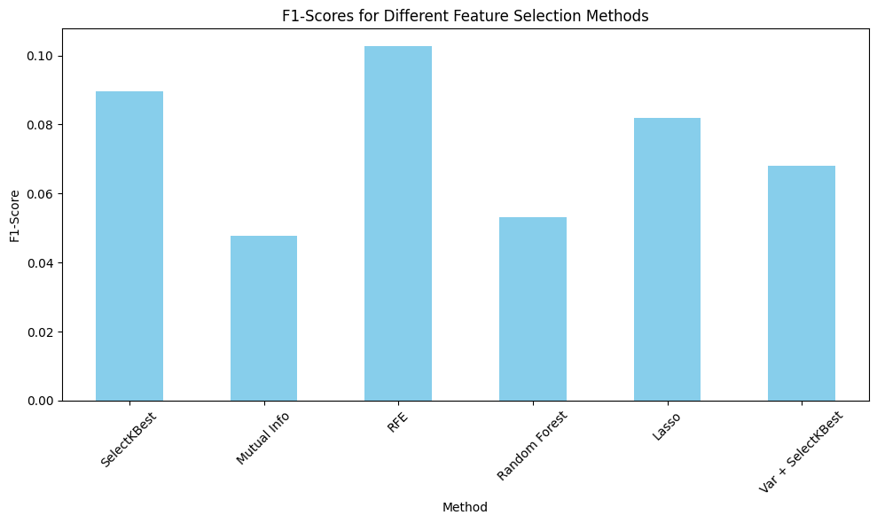
Feature Selection (cont.)
  Step 3: F1-Score by Feature Selection Method Bar Chart

Slide 21
Feature Selection (cont.)
  Step 4: Use Variance Inflation Factor (VIF) analysis and Backward Elimination with Logistic Regression with each method feature set to determine best LR model and corresponding F1-Score.
    Recursive Feature Elimination (RFE) with Logistic Regression
      Variance Inflation Factor (VIF) Results: removed 42 features due to high VIF (>10), ['35', '37', '38', '66', '118', '143', '151', '173', '175', '176', '178', '203', '205', '212', '214', '218', '269', '278', '286', '311', '313', '319', '322', '334', '337', '339', '341', '350', '352', '356', '391', '407', '444', '446', '447', '449', '455', '458', '476', '525', '565', '567’]
      Backward Elimination with Logistic Regression Results: 18 significant features, ['15', '27', '32', '33', '36', '59', '60', '65', '76', '100', '112', '122', '130', '147', '412', '417', '438', '558’], Pseudo R-square: 0.1954, Log-Likelihood: -307.81
      F1-Score with significant features: 0.2575

Slide 22
Feature Selection (cont.)
    Recursive Feature Elimination (RFE) with XGBoost
      Variance Inflation Factor (VIF) Results: removed 27 features due to high VIF (>10), ['17', '118', '156', '164', '185', '248', '253', '284', '299', '321', '346', '347', '386', '429', '478', '520', '550', '552', '555', '558', '565', '567', '568', '569', '570', '580', '581']
      Backward Elimination with Logistic Regression Results: 14 significant features, ['22', '60', '65', '74', '79', '125', '130', '147', '417', '431', '438', '512', '563', '576’], Pseudo R-square: 0.1916, Log-Likelihood: -309.26
      F1-Score with significant features: 0.2604
    L1 Regularization (Lasso)
      Variance Inflation Factor (VIF) Results: removed 21 features due to high VIF (>10), ['47', '68', '71', '141', '153', '160', '162', '163', '205', '226', '295', '296', '297', '298', '341', '364', '414', '426', '432', '437', '478']
      Backward Elimination with Logistic Regression Results: 14 significant features, ['15', '22', '60', '65', '74', '134', '434', '512', '542’], Pseudo R-square: 0.1377, Log-Likelihood: -329.88
      F1-Score with significant features: 0.2233

Slide 23
Feature Selection (cont.)
    Variance + SelectKBest
      Variance Inflation Factor (VIF) Results: removed 59 features due to high VIF (>10), ['22', '27', '64', '65', '66', '71', '123', '128', '139', '160', '161', '164', '165', '166', '167', '181', '184', '197', '198', '200', '204', '206', '295', '296', '300', '301', '302', '320', '334', '342', '412', '431', '432', '435', '436', '437', '438', '453', '456', '470', '472', '476', '478', '551', '552', '554', '555', '557', '558', '574', '578', 'missing_73', 'missing_74', 'missing_113', 'missing_248', 'missing_346', 'missing_347', 'missing_386', 'missing_520']
      Backward Elimination with Logistic Regression Results: 14 significant features, ['15', '23', '60', '112', '125', '130', '176', '317', '417', '461', '489', '511', '512', '570’], Pseudo R-square: 0.1930, Log-Likelihood: -308.72
      F1-Score with significant features: 0.2729
    SelectKBest
      Variance Inflation Factor (VIF) Results: removed 57 features due to high VIF (>10), ['27', '71', '122', '123', '124', '128', '160', '161', '164', '165', '166', '167', '181', '184', '197', '198', '200', '206', '211', '248', '295', '296', '299', '300', '301', '320', '349', '431', '432', '435', '436', '437', '438', '453', '456', '470', '472', '478', '520', '551', '552', '554', '555', '557', '558', '566', '568', '574', '576', 'missing_73', 'missing_74', 'missing_113', 'missing_248', 'missing_346', 'missing_347', 'missing_386', 'missing_520']
      Backward Elimination with Logistic Regression Results: 14 significant features, ['15', '22', '57', '60', '64', '65', '101', '112', '125', '130', '281', '512', '570'], Pseudo R-square: 0.1678, Log-Likelihood: -318.36
      F1-Score with significant features: 0.2197

Slide 24
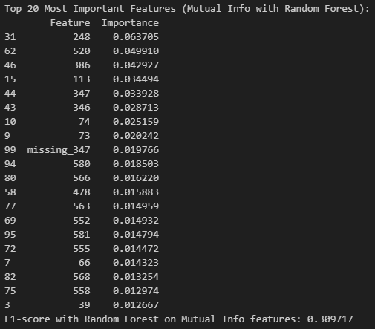
Feature Selection (cont.)
  Step 5: Use the Random Forest Classifier with Mutual Info method feature set to determine top 20 most important features and corresponding F1-Score, preserving potential predictive non-linear features.

Slide 25
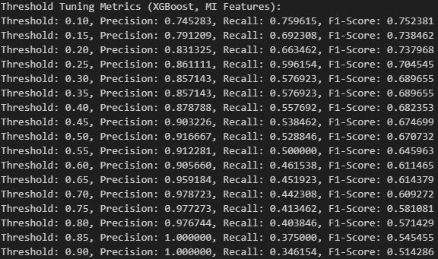

Machine Learning Model Creation
  Step 1: Train models utilizing XGBoost for three of the previously used feature sets (Mutual Info, RFE, and SelectKBest) and introduce three alternative feature selection methods (Boruta, SHAP, and L1 via XGBoost).
    Mutual Info features trained with XGBoost.

Slide 26
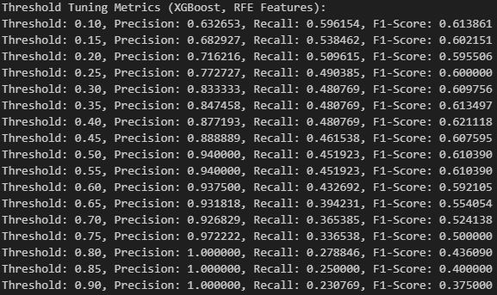

Machine Learning Model Creation (cont.)
    Recursive Feature Elimination (RFE) features trained with XGBoost Classifier.

Slide 27
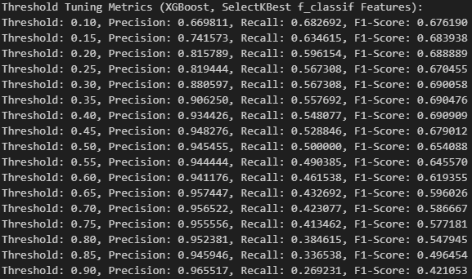

Machine Learning Model Creation (cont.)
    SelectKBest features trained with XGBoost Classifier.

Slide 28
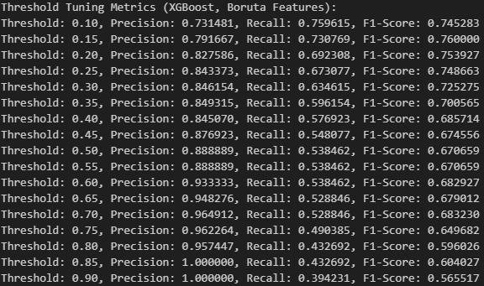

Machine Learning Model Creation (cont.)
    Boruta features trained with XGBoost Classifier.
      Boruta-Selected 28 Features: ['17', '22', '34', '60', '65', '68', '74', '96', '113', '125', '141', '151', '240', '248', '284', '346', '347', '424', '427', '524', '555', '563', '565', '569', '570', '581', 'missing_73', 'missing_113']

Slide 29
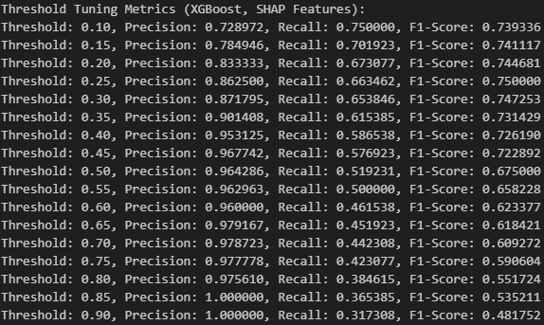

Machine Learning Model Creation (cont.)
    SHAP features trained with XGBoost Classifier.
      SHAP-Selected 100 Features: ['113', '346', '248', '60', '74', '73', '581', '569', '563', 'missing_73', '556', '564', '11', '582', '558', '386', '1', '347', '548', '570', '22', 'missing_113', '470', '567', '164', '478', '299', '91', '520', '512', '308', '461', '572', '160', '547', '249', '576', '492', '103', '313', '568', '555', '134', '554', '46', '301', '163', '487', '566', '206', '182', '432', '549', '352', '173', '580', '426', '185', '288', '128', '552', '15', '87', '272', '284', '114', '17', '557', '172', '297', '485', '104', '96', '292', '41', '117', '427', '80', '565', '447', '141', '153', '551', '588', '589', '489', '161', '123', '147', '438', '151', '125', '34', '146', '19', '333', '5', '181', '420', '240']

Slide 30
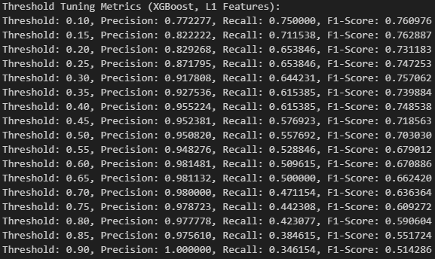

Machine Learning Model Creation (cont.)
    L1 features trained with XGBoost Classifier.
      L1-Selected 100 Features: ['missing_113', '248', '570', '15', 'missing_73', '34', '347', '154', '563', '60', '377', '300', '284', '569', '21', '391', '91', '188', '565', '73', '337', '74', '213', '113', '291', '346', '92', '68', '24', '552', '90', '125', '525', '524', '548', '131', '547', '556', '89', '490', '349', '130', '116', '65', '103', '341', '368', '121', '118', '575', '105', '469', '22', '581', '424', '564', '491', '582', '30', '474', '3', '189', '148', '299', '319', '486', '17', '339', '555', '566', '576', '476', '160', '63', '96', '317', '572', '278', '93', '23', '80', '206', '432', '567', '147', '59', '477', '431', '20', '85', '114', '38', '41', '332', '11', '478', '308', '151', '172', '511']

Slide 31
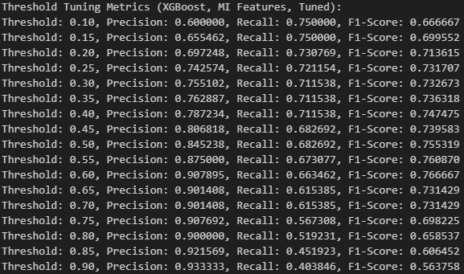

Machine Learning Model Creation (cont.)
  Step 2: Optimize models utilizing XGBoost by utilizing GridSearchCV to determine appropriate grid parameters.
    Mutual Info features optimized with XGBoost. Best F1-Score (Grid Search, MI Features): 0.7525
    Best Parameters (MI Features): {'gamma': 0, 'learning_rate': 0.1, 'max_depth': 6, 'n_estimators': 120, 'reg_alpha': 0, 'reg_lambda': 0.1, 'scale_pos_weight': 14, 'subsample': 1.0}

Slide 32
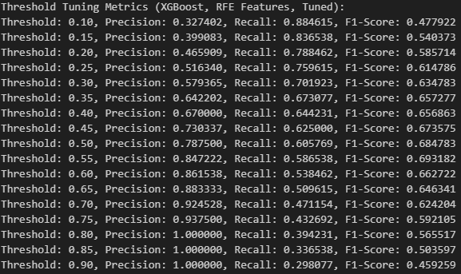

Machine Learning Model Creation (cont.)
    Recursive Feature Elimination (RFE) features optimized with XGBoost. Best F1-Score (Grid Search, RFE Features): 0.6798
    Best Parameters (RFE Features): {'gamma': 0, 'learning_rate': 0.1, 'max_depth': 3, 'n_estimators': 120, 'reg_alpha': 0.1, 'reg_lambda': 0.1, 'scale_pos_weight': 14, 'subsample': 1.0}

Slide 33
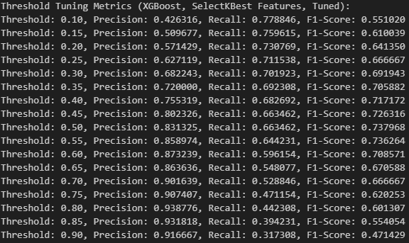

Machine Learning Model Creation (cont.)
    SelectKBest features optimized with XGBoost. Best F1-Score (Grid Search, SelectKBest Features): 0.7379
    Best Parameters (SelectKBest Features): {'gamma': 0, 'learning_rate': 0.3, 'max_depth': 3, 'n_estimators': 50, 'reg_alpha': 0, 'reg_lambda': 0.1, 'scale_pos_weight': 14, 'subsample': 1.0}

Slide 34
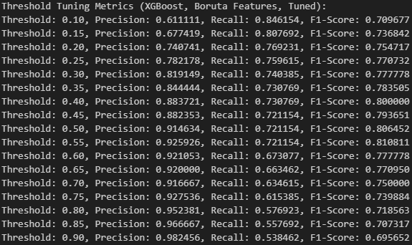

Machine Learning Model Creation (cont.)
    Boruta features optimized with XGBoost. Best F1-Score (Grid Search, Boruta Features): 0.8039
    Best Parameters (Boruta Features): {'gamma': 0, 'learning_rate': 0.1, 'max_depth': 3, 'n_estimators': 200, 'reg_alpha': 0, 'reg_lambda': 0, 'scale_pos_weight': 14, 'subsample': 1.0}

Slide 35
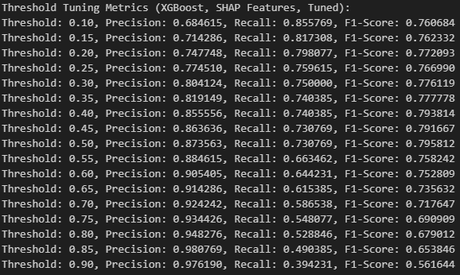

Machine Learning Model Creation (cont.)
    SHAP features optimized with XGBoost. Best F1-Score (Grid Search, SHAP Features): 0.7925
    Best Parameters (SHAP Features): {'gamma': 0, 'learning_rate': 0.1, 'max_depth': 3, 'n_estimators': 260, 'reg_alpha': 0.1, 'reg_lambda': 0.1, 'scale_pos_weight': 14, 'subsample': 1.0}

Slide 36
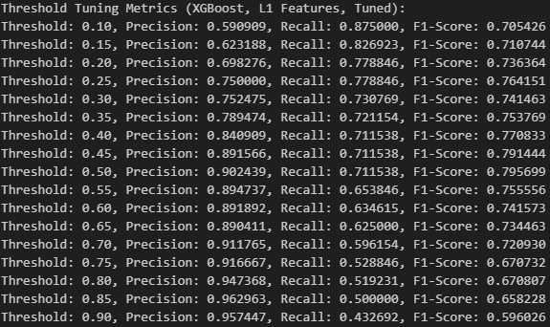

Machine Learning Model Creation (cont.)
    L1 features optimized with XGBoost. Best F1-Score (Grid Search, L1 Features): 0.7895
    Best Parameters (L1 Features): {'gamma': 0.3, 'learning_rate': 0.1, 'max_depth': 3, 'n_estimators': 250, 'reg_alpha': 0, 'reg_lambda': 0, 'scale_pos_weight': 14, 'subsample': 1.0}

Slide 37
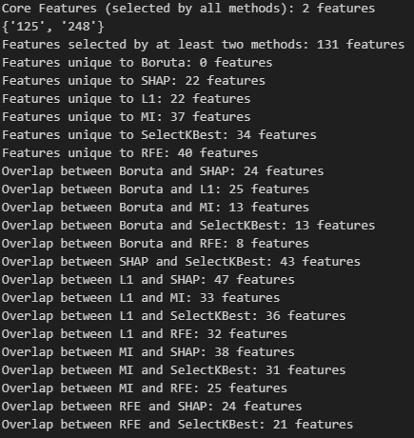
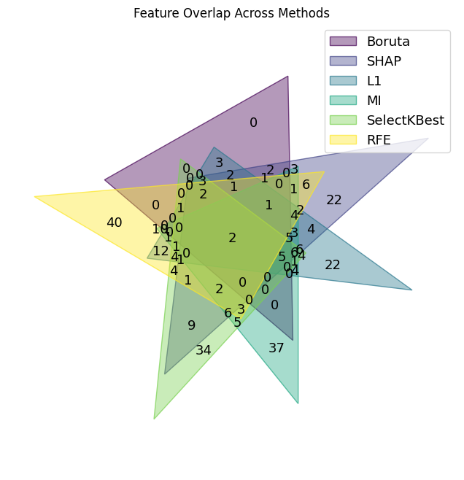
Machine Learning Model Creation (cont.)
  Step 3: Summary of Overlays and a Venn Diagram

Slide 38
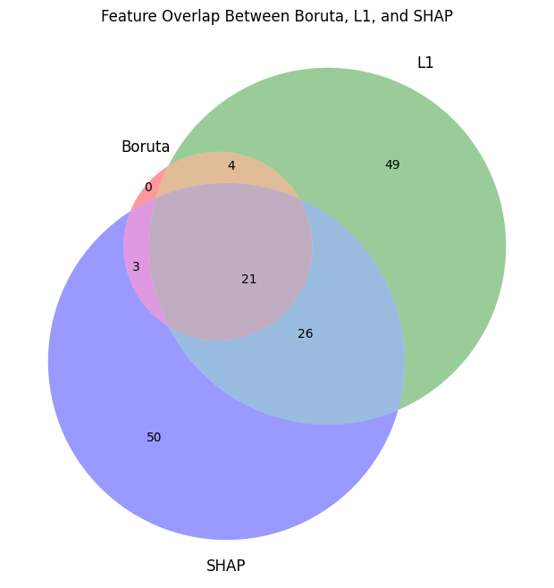
Machine Learning Model Creation (cont.)
  Step 4: Best F1-Scores Obtained
      Boruta (28 features): 0.810811
      Boruta + Top 11 from SHAP ∩ L1 (39 features): 0.804124
      Boruta + SHAP ∩ L1 (~54 features): 0.793814
      Boruta + SHAP + L1 (153 features): 0.789744
      Boruta + Unique SHAP + Unique L1 (127 features): 0.789474
      Boruta + Features Selected by At Least 3 Methods (70 features): 0.786885
      Features Selected by At Least Two Methods (131 features): 0.772093
      Boruta + SHAP ∩ L1 + At Least 4 Methods (57 features): 0.775956

Slide 39
Conclusion
  Through an extensive exercise of strategic data preprocessing, feature selection, and model testing, it was discovered that the Boruta feature selection with a XGBoost Classifier with tuned grid parameters using GridSearchCV yielded the most robust model.
      Boruta-Selected 28 Features: ['17', '22', '34', '60', '65', '68', '74', '96', '113', '125', '141', '151', '240', '248', '284', '346', '347', '424', '427', '524', '555', '563', '565', '569', '570', '581', 'missing_73', 'missing_113’]
      Best Threshold: 0.55
      Precision: 0.925926
      Recall: 0.721154 ANA630 Advanced Analytic Applications
      F1-Score: 0.810811 Randall Crawford 5/2/2025

